Slide 1
Autonomous Cars
Daria Zahaleanu

Slide 2
Why are self-driving cars vulnerable to cyberattacks?
It hauls from the malicious attacks against deep learning models
Last year, researchers at CMU demonstrated that state-of-the-art face recognition algorithms could be defeated by wearing a pair of clear glasses with a funky pattern printed on their frames.
There are studies that show that one can jam various sensors on a Tesla S, making objects invisible to its navigation system
Not only car components and sensors, but also traffic signs can be maliciously modified to trick the neural network of the cars

Slide 3
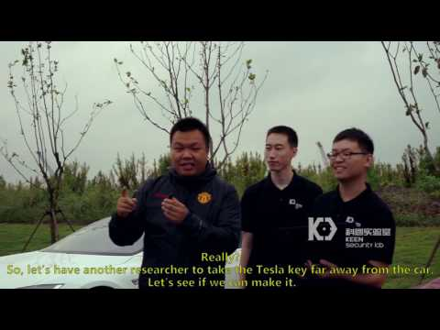

Slide 4
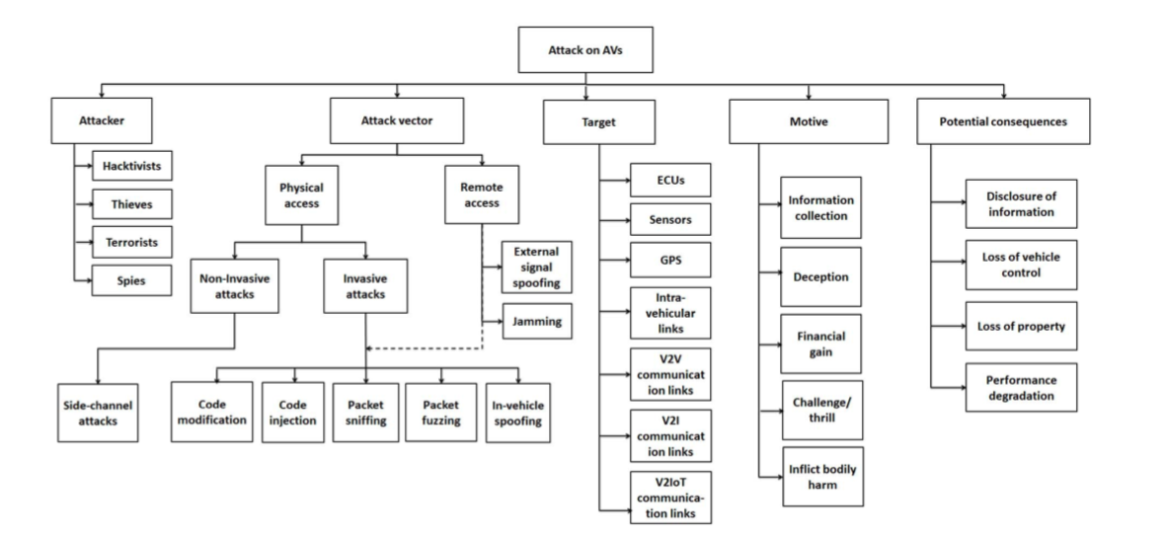
Types of Attacks

Slide 5
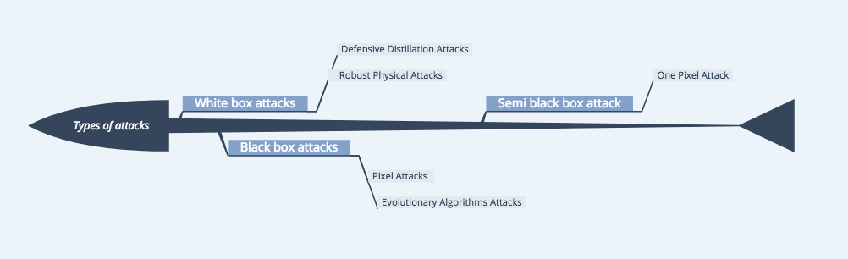

Slide 6


Slide 7
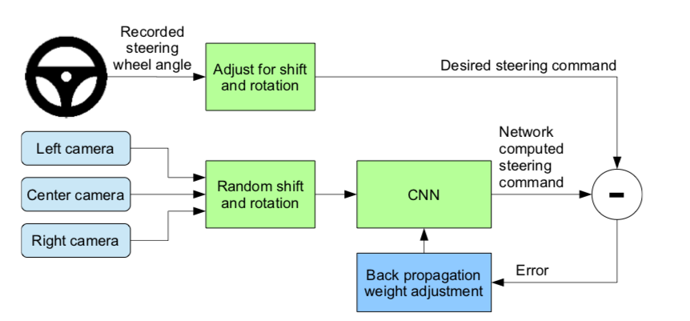
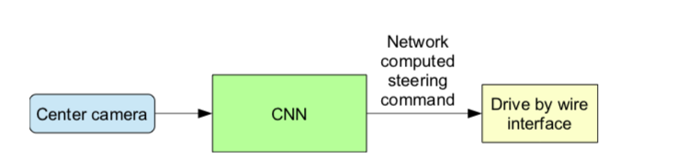
Training Mode
Autonomous Mode

Slide 8
Demo

Slide 9
Black-Box Attacks
in black-box attacks, the adversary doesn’t have any knowledge about the model, except for the the labels
the goal is to produce a minimal perturbation to input X, sufficient to determine the DNN to misclassify it, but imperceptible enough for the human eye
Notes:
Unlike the other two type of attacks, classified as white-box attacks, as the adversary has full access to the internal structure of the classifier, in black-box attacks, the adversary doesnâ€™t have any knowledge about the model, except for the the labels, the allow him/her access to the output only. The goal is as we previously saw, to produce a minimal perturbation to input X, sufficient to determine the DNN to misclassify it, but imperceptible enough for the human eye. The approach to this type of attack is as following: use DNN as an orale to synthesized data and generate a synthetic data set S0 to build a model F that approximates the oracleâ€™s decision. Then using the new architecture F to craft adversarial samples, the oracle outputs a misclassified probability vector, corresponding to input X*. This step, called substitute DNN training algorithm, ends with the Jacobian-based dataset augmentation, which generates a new set of data S (Figure 7). Once the adversary training a substitute DNN, it uses it to craft adversarial samples, by using two types of algorithms: Goodfellow, or the fast gradient sign method and Papernot. Therefore, the black-box attack generalizes to machine learning models that are not necessarily DNNs, regardless of the differentiability of the functions.

Slide 10
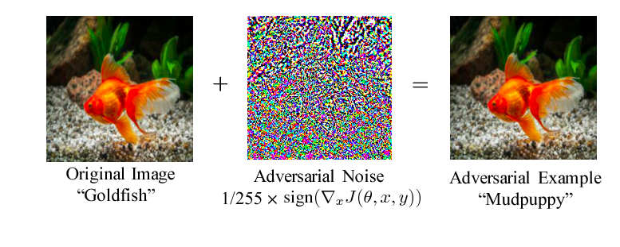
Regular Pixel Attack
Notes:
The black-box attack requires only the probability labels (the probability value for each category) that get outputted by the neural network.

Slide 11
One Pixel Attack
Instead of limiting the length of the perturbation vector, we propose the limitation of the number of pixels that can be modified
In this paper, there is ideally only one pixel which is modified with differential evolution
Advantages of this attack:
Analysis of the vicinity of natural images by limiting the search sphere region
A measure of perceptiveness by limiting the perturbations

Slide 12
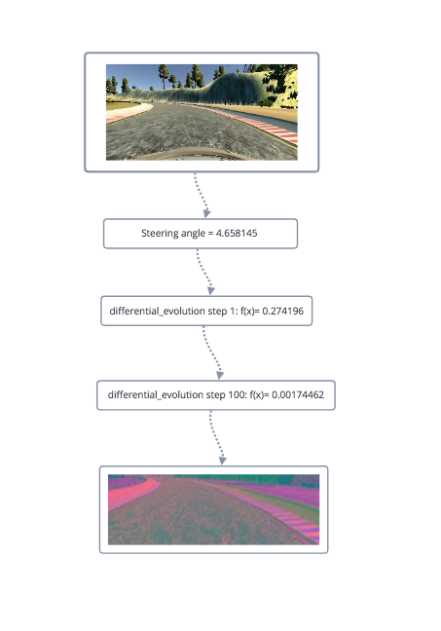
Differential Evolution
= evolutionary algorithm that encodes the perturbation into an array which is optimized through differential evolution
= during each iteration, a set of solutions is generated according to the current population
Notes:
= approximates the minimum of the

Slide 13
Two variations of the attack
Attack on the steering angle
Attack on the distance between two images

Slide 14
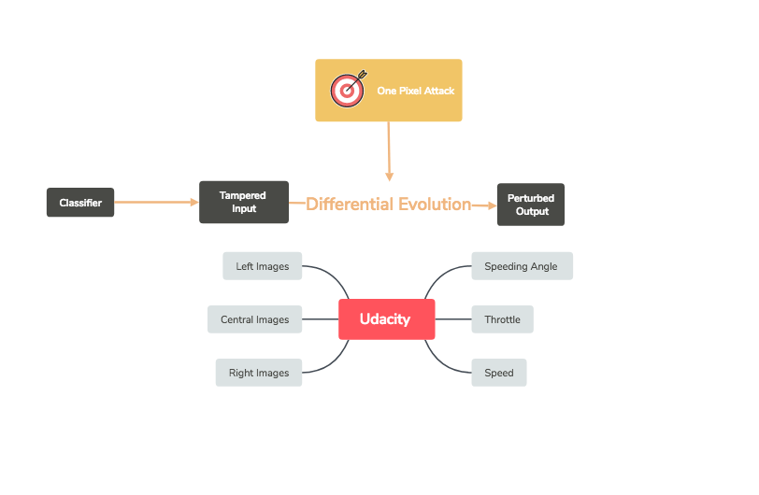
Attack Scheme
Notes:
Diff evolution = evolutional algorithm, that works with complex numbers; during each iteration another set of candidate solutions (children) is generated according to the current population (fathers). Then the children are compared with their corresponding fathers, sur- viving if they are more fitted (possess higher fitness value) than their fathers. In such a way, only comparing the father and his child, the goal of keeping diversity and improving fitness values can be simultaneously achieved.

Slide 15
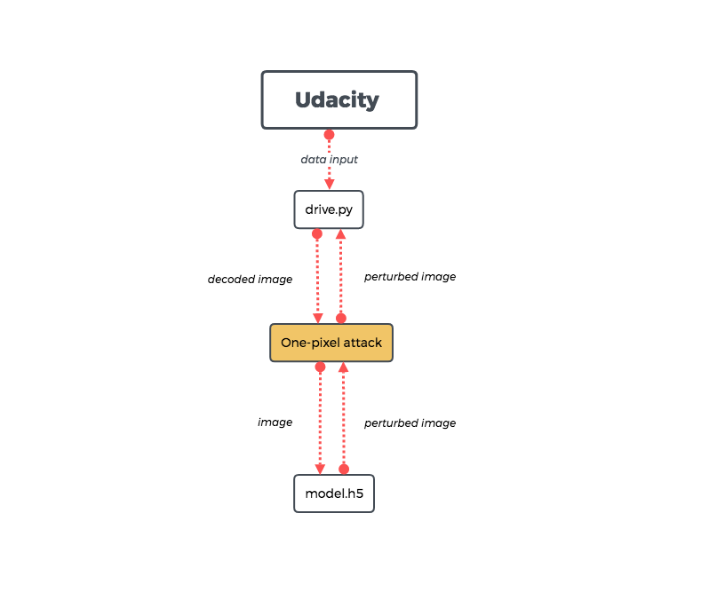

Slide 16
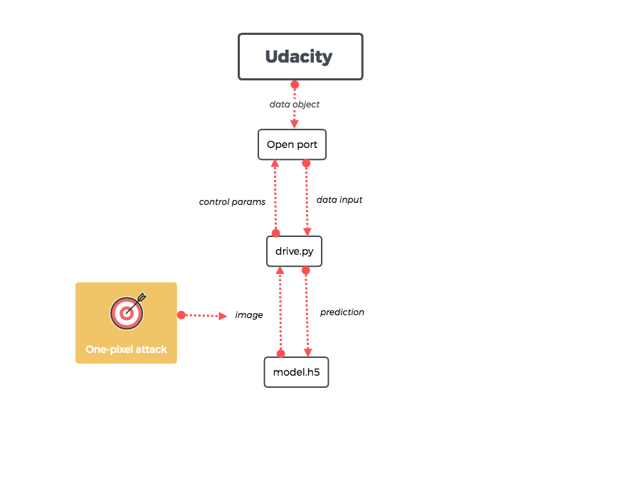

Slide 17
Attack on the steering angle prediction

Slide 18
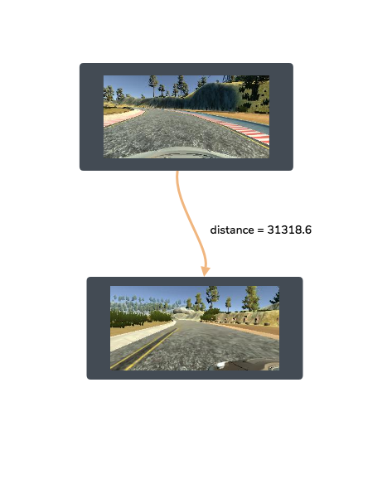
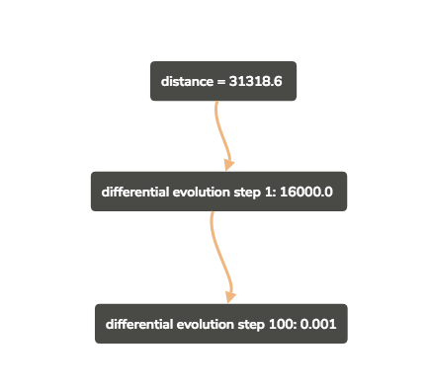
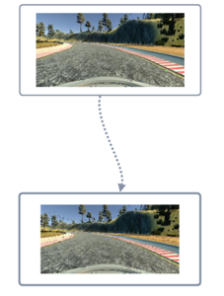
Attack on the distance between two images

Slide 19
Results and Future Work
Identified vulnerabilities in the model produced by Udacity
Ran two variations of the one pixel attack
Improve the attack by tampering with the classifier

